Slide 1
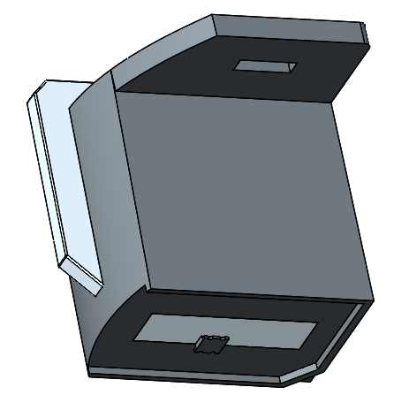
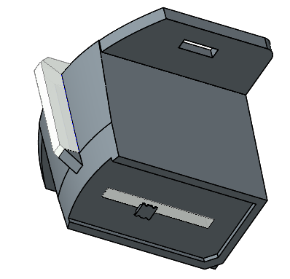
Compare with the mockup sample, we decrease the in-light surface for better tooling design, as right picture shows, that will decrease the light that enter into the in-light surface.
For tooling sample, we will add 0.7% diffuser into light pipe material, that will soften the light.
In-light surface
In-light surface
LED
LED
Mockup
Tooling

